Slide 1
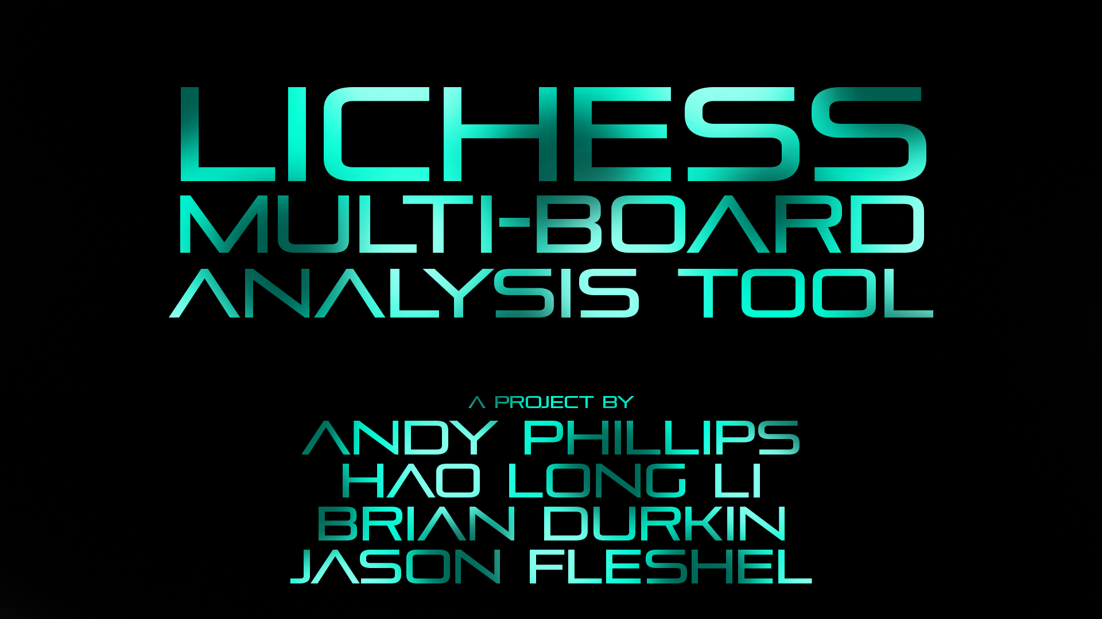
Lichess Multi-Board Analysis Tool a project by Andy Phillips, Hao Long Li, Brian Durkin, and Jason Fleshel

Slide 2
The Main Idea
Goal: Introduce a new analysis tool for Chess players based on data from Lichess API

Slide 3
The Main Idea
Goal: Introduce a new analysis tool for Chess players based on data from Lichess API
Enable self-analysis of multiple games at once, side-by-side

Slide 4
The Main Idea
Goal: Introduce a new web-based analysis tool for Chess players based on data from Lichess API
Enable self-analysis of multiple games at once, side-by-side
Search the games database from Lichess to capture up to 500 games at once

Slide 5
Project Breakdown
Two main parts:

Slide 6
Project Breakdown
Two main parts:
Search functionality

Slide 7
Project Breakdown
Two main parts:
Search functionality
Board management

Slide 8
Project Breakdown
Two main parts:
Search functionality
Board management
Search involves:
Querying the Lichess API for data
Filtering data
Presenting results
Allow user to view the game on the page

Slide 9
Project Breakdown
Board management involves:
Organizing the boards on the screen
Enabling individual and simultaneous control of board state
Add/Remove boards at will

Slide 10
Project Breakdown
Every component has multiple pieces:
User interface/visual
Interaction/event handling

Slide 11
Project Breakdown
Every component has multiple pieces:
User interface/visual
Interaction/event handling
Limited the scope of client/server interactivity
No database, only interaction with one API
Wanted to keep web development elements simple for newcomers to the discipline

Slide 12
Responsibility Breakdown
Andy, Product Owner
Organized product development based on user personas (Product backlog, Sprint backlog)
Built majority of backend infrastructure for search component
Created simultaneous board controls
Created and maintained:
UML
Project proposal
Board creation and destruction sequence diagrams

Slide 13
Responsibility Breakdown
Li, Developer
Create a function to display the search results of the User Games API call in a scrollable UI panel
Add search filter UI "opening" as a search box with opening suggestion
Add ability to remove game from page
Search UML Sequence Diagram

Slide 14
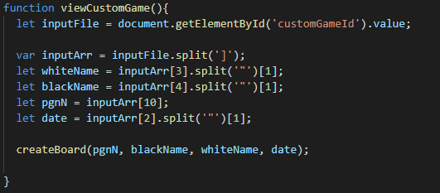
Responsibility Breakdown
Brian, Developer
Mainly in charge of styling and CSS
Created ability to add a custom PGN board and compare it with other boards
Added styling to the Javascript elements of the website

Slide 15
Responsibility Breakdown
Jason, Developer
Wrote method to create board in JavaScript and add it to page
Added a button for each search result to invoke that method
Added responsive CSS using Bulma library
Updated UML Diagrams

Slide 16
Impact of Team Changes
Total of 3 teammate changes
Felix left before we really started the project

Slide 17
Impact of Team Changes
Total of 3 teammate changes
Felix left before we really started the project
Jason joined us during week 2

Slide 18
Impact of Team Changes
Total of 3 teammate changes
Felix left before we really started the project
Jason joined us during week 2
Keshav left us during week 3

Slide 19
Impact of Team Changes
Total of 3 teammate changes
Felix left before we really started the project
Jason joined us during week 2
Keshav left us during week 3
Had moderate impact on progress

Slide 20
Impact of Team Changes
Total of 3 teammate changes
Felix left before we really started the project
Jason joined us during week 2
Keshav left us during week 3
Had moderate impact on progress
Some teammates had little prior web development exposure
Kept technical complexity of project on the lower side to compensate for team changes and lack of experience

Slide 21
Team Meeting and Communication
No regular meetings

Slide 22
Team Meeting and Communication
No regular meetings
Constant communication via Discord

Slide 23
Now for a brief demo!

Slide 24
Skill Growth: Andy
Gained project management experience
Have web development experience, but not much product ownership experience
Working with people of various web dev skill levels was an interesting challenge
Gained more in-depth experience with tools like GitHub and Trello for project management
Releases, general repo management
Tagging/Task Organization in Trello

Slide 25
Skill Growth: Li
Experience working with a organized group
Following up with other’s work and communicating with others in a organized manner to make things work was very new to me.
Experiencing Scrum
Coding skills
Improved on HTML, CSS and Javascript knowledge
learning to interact with APIs
GitHub and Trello
Better understand of some Github and Trello functions that I was not as familiar with before
Adapting as we go
Me and the group learned when to let go of an idea to look for a better one different occasion.

Slide 26
Skill Growth: Brian
Gained experience in adding to Github projects
Did not have much experience in this before
Took some learning but figured it out
Gained web development experience
Learned lots of new CSS
Further enriched JavaScript knowledge and how to use it outside of CIS 3308
Wants to be a front-end web developer so this was very useful

Slide 27
Skill Growth: Jason
Developed frontend web development skills
Learned useful JavaScript libraries
Developed teamwork skills
Contributing to GitHub and marking changes in Trello
Updated code in weekly sprints
Participated in multiple weekly SCRUM meetings

Slide 28
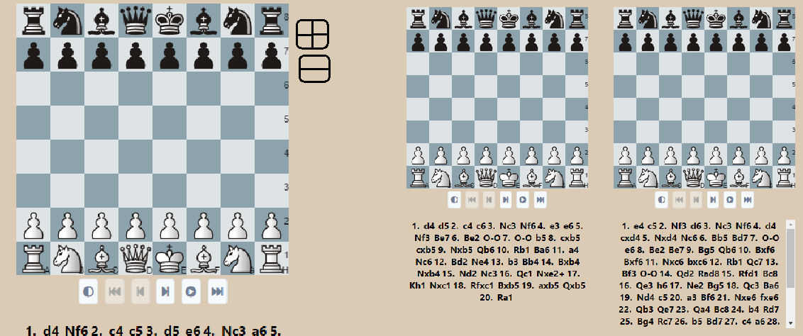
What wasn't implemented?
Scaling boards on page

Slide 29
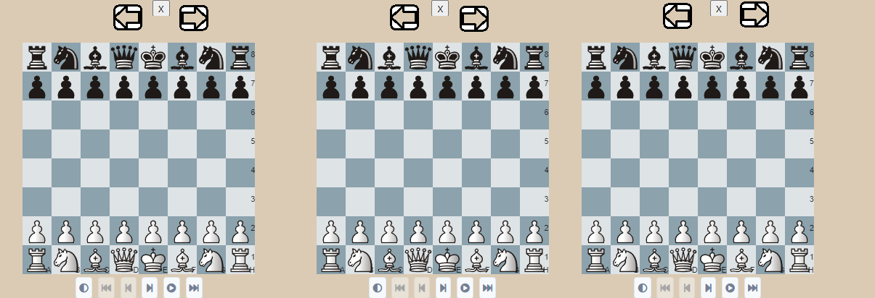
What wasn't implemented?
Functionality to allow shifting of boards on page

Slide 30
Any questions?

